Slide 1
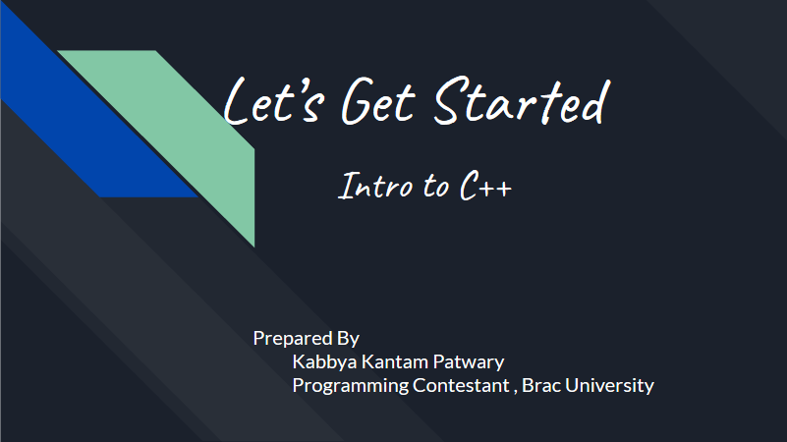
Let’s Get Started
Intro to C++
Prepared By
Kabbya Kantam Patwary
Programming Contestant , Brac University

Slide 2
Tb to Java Same Code in C++
import java.util.*;
class Main {
public static void main(String args[]){
System.out.println ( " Hello World " );
}
}
#include <bits/stdc++.h>
using namespace std;
int main() {
cout<<"Hello, World"<<endl;
return 0;
}
Notes:
#include <bits/stdc++.h> works same as import java.util.* - includes all necessary header files
Int main () is same as public static void main(String args[]) - Main function
cout is used for displaying output. There is another way for showing output, printf
Put return 0 ; before cout ; see what happens
What if we don’t write return 0, or what if we write return 5;
What will happen if we write return ‘a’;
What is the reason of using namespace std (see next slide);
Print the statement without endl , what’s the difference ?

Slide 3
Why we use Namespace std ?
BRACU :: Library
BRACU :: Cafeteria
BRACU :: Prangoan
BRACU :: Grade_System
BRACU :: Student
Using namespace BRACU;
Library
Cafeteria
Prangoan
Grade_System
Student
Notes:
We are telling the compiler that we are using standard (std) library.
If we don’t use namespace std in our code then we have write std :: cout , std :: cin , std :: vector and so on.

Slide 4
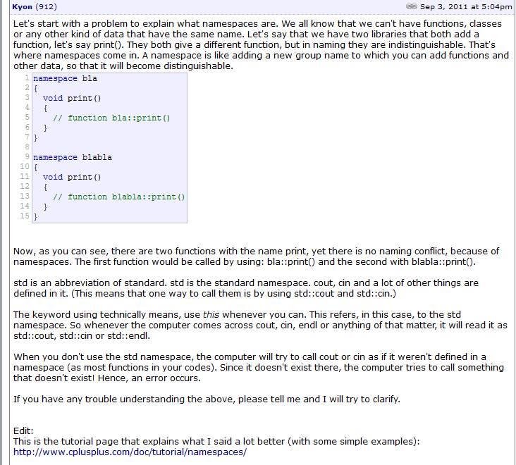
continue..
In more details…..

Slide 5
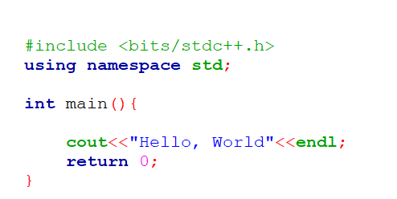
Jumping into C++

Slide 6
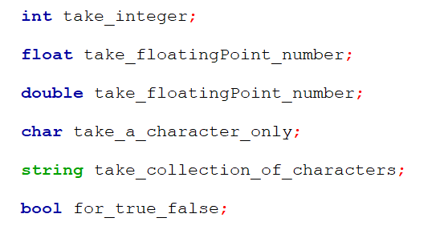
Data Types and Variable Declaration
Notes:
We will avoid using float, always double is preferable.
Why the color of string is Green ? :p
And another thing, in java we write String, but here s is in small letter
Find out.

Slide 7
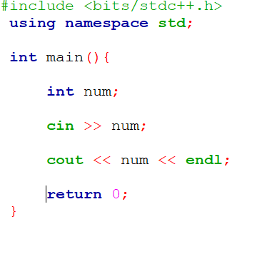
Taking input
We can use cin or scanf to take input.
How to use cin to take input :

Slide 8
Writing code
Now we know about the variable declaration, I/O operation.
NOW,can we write a code where user will give two integers, and we have to print the summation of those two numbers ?
But where to Code ? :p

Slide 9
IDE
We can install Codeblocks to run c, c++ code.
Download link : http://www.codeblocks.org/downloads/26
Windows users download codeblocks-17.12mingw-setup.exe file.
There are also some Online IDE
https://ideone.com/
https://repl.it/
You can open account and save your codes here.

Slide 10
File extension
Learn how to use Codeblocks.
If you use codeblocks, then Save file as file_name.cpp
If you don’t add extension .cpp, your code will be treated as c code in codeblocks.

Slide 11
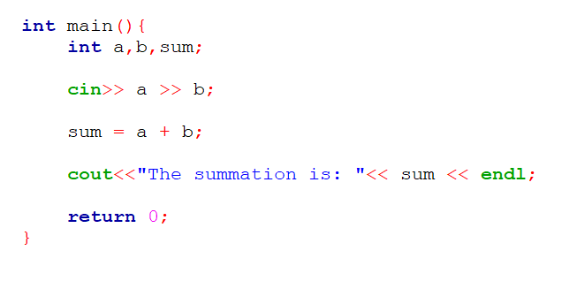
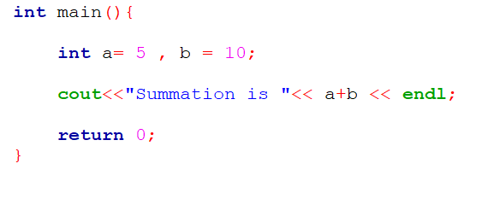
Task 01 : Solve : Don’t Look at the Code :p
Notes:
Task 01 : Take two integers from user and show the summation as output.

Slide 12
Task 2 :
Same as task 1.
What we have to do is simply, take two integers from user and multiply them. Show the output.

Slide 13
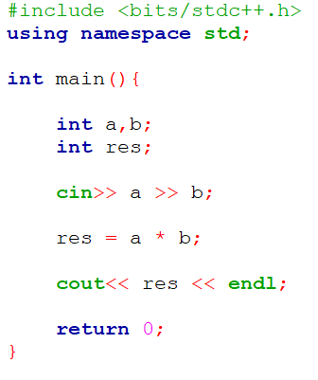
Solve of task 02
Time to check the code.
Calculate the result for 1000000 and 1000000.
What’s the output ?
Having trouble ?
Variables a and b both are int , they can store 1000000. But the output will be 10^12. Which can’t be stored using int.

Slide 14
Range of data type
Int : Has 32 bits or 4 bytes [ 1 byte = 8 bits]
Range of Int : -2,147,483,648 to 2,147,483,647
Long long : Has 64 bits or 8 bytes [ 1 byte = 8 bits]
Range of long long : -9223372036854775808 to 9223372036854775807

Slide 15
How we can calculate range
Suppose we have a data type which takes integers and has 4 bits.
Now do task 2.
Notes:
The First bit is a Sign bit. If it is 0 , then the number will be 0. If the bit is 1, then the number is negative.
So we have 3 bits left. Every position will hold either 0 or 1, means every bit have 2 options.
It can value between - ( 2*2*2 ) to (2*2*2) - 1 = -8 to 7
Try to recall why there is minus 1 for positive range (discussed at class)
General formula = 2^(n-1) to 2^(n-1) - 1

Slide 16
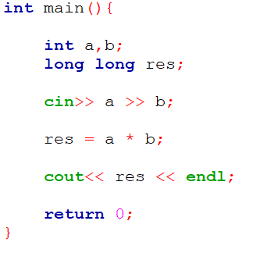
Solve of task 02 continue
Now ,Calculate the result for 1000000 and 1000000 again.
What’s the output ?
Still Having trouble after declaring variable res as long long ?
Why ?
If we add two int , then it will always produce int.
Same as, when we divide int / int , we get int value, not decimal value.

Slide 17
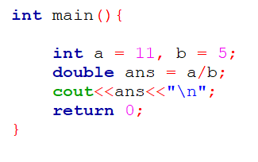
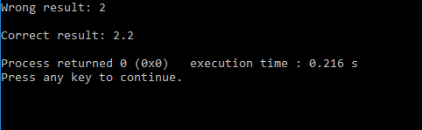
Things need to be handled carefully
Int + int int
Int / int int
Int * int int
How to solve this problem ?

Slide 18
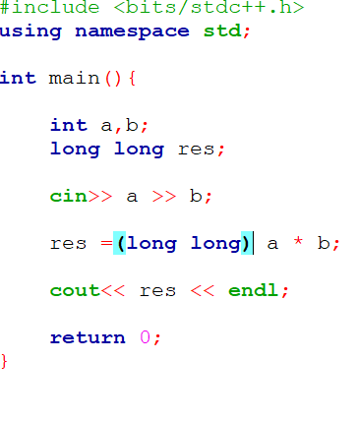
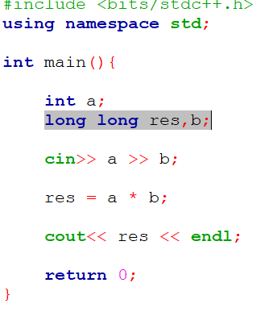
Some techniques
Notes:
ss _01 - type cast
Ss_02 - instead of having int + int , we are now calculating int + long long

Slide 19
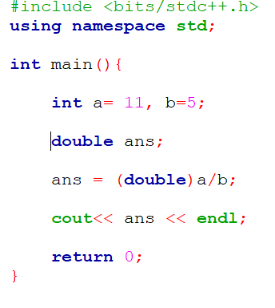
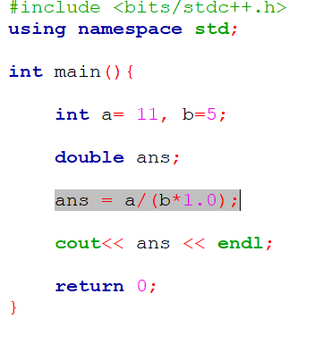
Some techniques

Slide 20
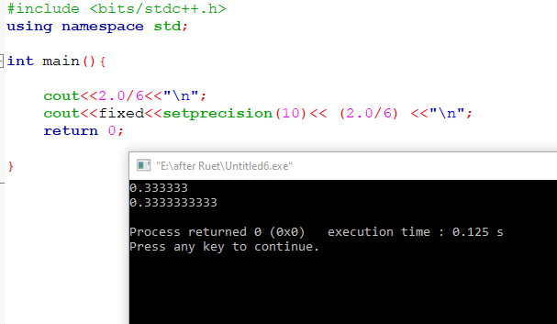
After decimal point

Slide 21
Can we store 2^63 ?
Unsigned long long
Variable Declaration : unsigned long long num;
Bits = 64 bits
Range = 0 to 2^64 - 1

Slide 22
Use of If / else
Similar to Java

Slide 23
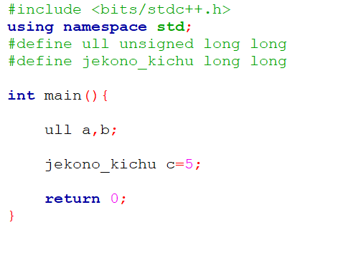
A glimpse of poshness in c++
.

Slide 24
Task 03
Take four integers a,b,c and d from user. And calculate if a/b = c/d ?
If a/b equals to c/d , print “YES”
Otherwise “NO”
a/b = c/d ??
Constraint : 0<= a , b , c , d <= 1000

Slide 25
Task 3 solution - Change the equation
Matter of Concern
1) Precision error
2) divided by Zero , will give Runtime Error
#include <bits/stdc++.h>
using namespace std;
int main(){
int a,b,c,d;
cin>> a >> b >> c >> d;
if(a*d == b*c) cout<<"YES"<<endl;
else cout<<”NO"<<endl;
return 0;
}

Slide 26
Few more Tasks
Task 04 : Take a character from user, if it is ‘a’ ‘e’,‘i’,‘o’, ‘y’ then print “VOWEL”
Otherwise print “CONSONANT”
Task 05 : Take a number from user, determine whether the number is Positive Integer, Negative Integer or Zero?
Task 06: User will give his marks for a certain course, determine his grade point based on BRACU Grading System.
Notes:
If you have missed letter ‘y’ as a vowel, then you will get WA (wrong answer)

Slide 27
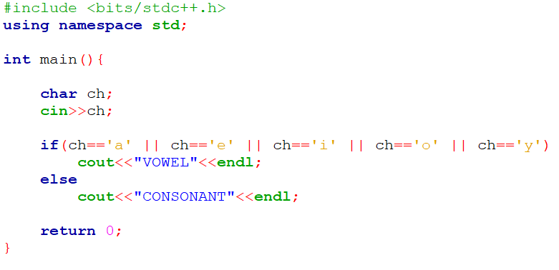
Task 04 : Don’t look at the solution :p

Slide 28
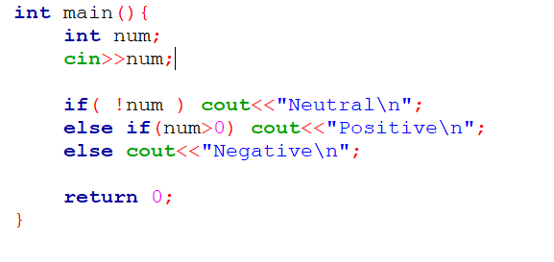
Task 05 : Don’t look at the solution :p
Notes:
How it is working ? If ( !num )
Can we do similar thing in java ?

Slide 29
String
Taking input in string
Variable declaration ---- string str ;
a single word - cin >> str ;
Multiple words / a Line - getline ( cin, str ) ;
Find length = string_name.size ()

Slide 30
Loop
For loop
While loop
Do while
SAME AS JAVA

Slide 31
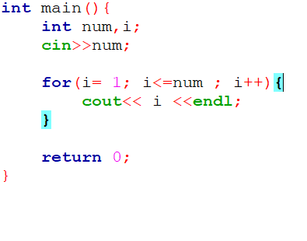
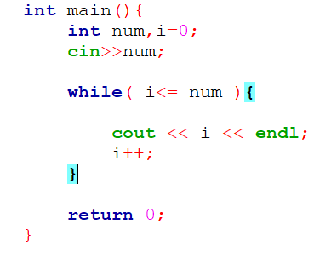
For loop While loop - print 1 to N
Notes:
What if we need to print 2 4 6 8 10 …….. N

Slide 32
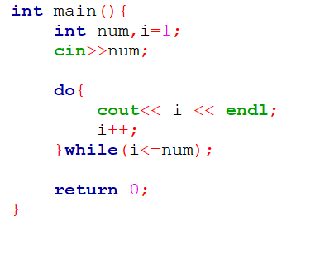
Do while - print 1 to N
What if, the problem says, user will give N and you have to print from 1 to N-1.
For example:
5
You should print - 1 2 3 4
Suppose you are using do while to solve this problem.
See what will happen if user give 1 as input.

Slide 33
Problems on Loop
Task 07 : user will give you a number, find out factorial of that number.
Formula of factorial = 1 * 2 * 3 * …….. * n-1 * n
Task 08 : user will give you N, find out the summation of the numbers from 1 to N.
Example : input : 5
Output : 15 ( 1 + 2 + 3 + 4 + 5 )
*challenge : Do task 08 without using loop.

Slide 34
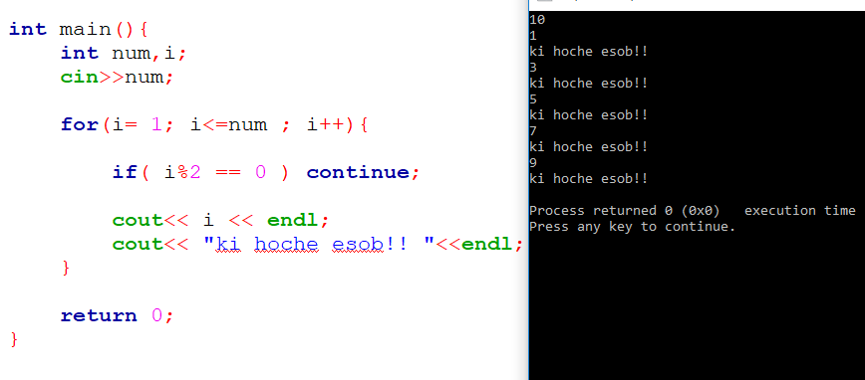
Use of Continue

Slide 35
Palindrome
RACECAR
MADAM
123321
Now we will see how we can use break through solving this problem.

Slide 36
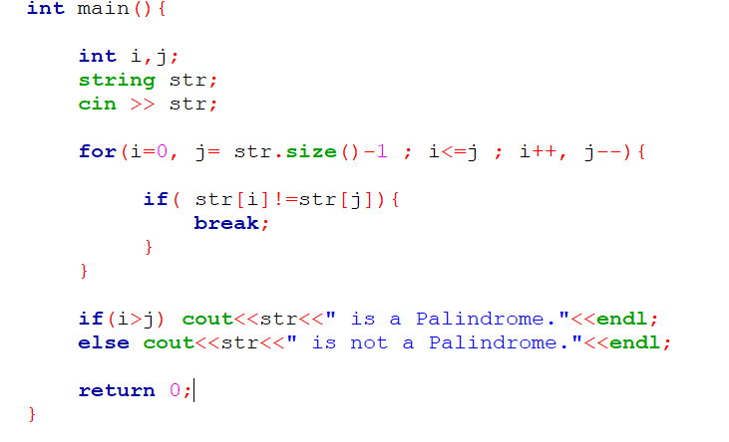
Use of break
Notes:
You should careful about the scope of variable i and j

Slide 37
Array
Array declaration:
Int arr [ 5 ];
Int arr [ ] = { 5, 2 , 1 , 6 , 8 };
Indexing is same as Java. If we declare int a[5]
Index : 0 1 2 3 4
Array size = sizeof(arr)/sizeof(*arr); // But, we don’t need to use it as much, because we already know the size of our array while declaring the array

Slide 38
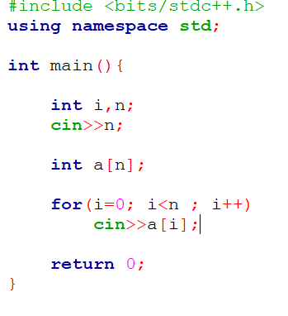
Taking Input in Array (Try to print the elements also)
User will give you N, total number of integers. You have to store the value using array.
For example,
5( will decide how many element user will give)
2
3
4
1
9

Slide 39
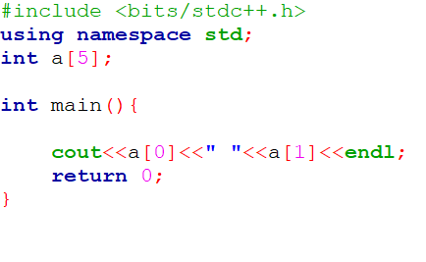
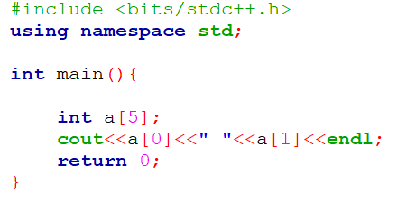
Global vs Local
Array declaration locally
Array declaration Globally
Notes:
Any difference ?
See also, what is the maximum size of the array you can declare. Is it same for both types of declaration ?

Slide 40
Initialization with 0 (When array is declared locally)
Int a[5];
for(i=0; i <5; i++) a[i]=0;
2) int a[5]={0};
3) int a[5];
memset( a, 0 , sizeof(a) );

Slide 41
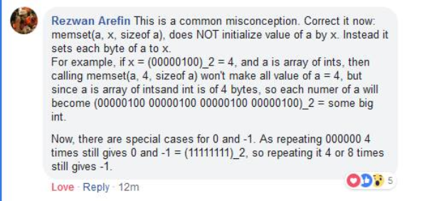
memset ( array_name, 0 / -1 , sizeof(array_name) )
Using memset we can make all the elements of 0 or -1. It only works for 0 and -1.

Slide 42
Task 09 - counting the occurence
You will be given total number of input, N ( 1 <= N <= 100000). Next N lines will contain a single integer p ( 1<= p <= 100 ).
You have to print the occurrence of the given numbers in ascending order.
Input : 6 output
1 1 has been given 2 times
2 2 has been given 1 times
1 7 has been given 1 times
9 9 has been given 2 times
9
7

Slide 43
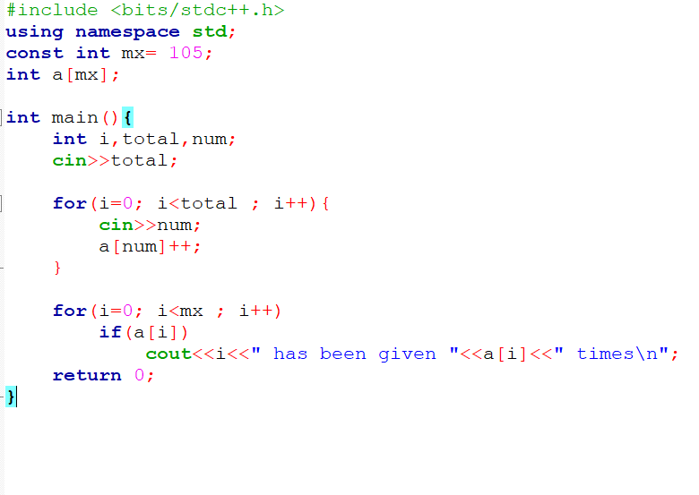
Solve 09
Notes:
Anything new in this code !!
Why the array is declared globally ?
Try to avoid const, does your code compile ?
Why I have declared the array of size 105 , based on what ?
What is “ \n “ here ?

Slide 44
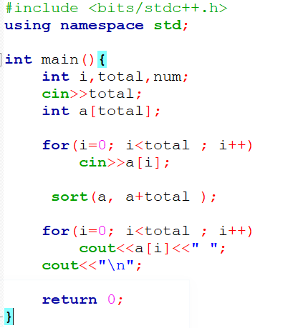
Task 10
User will give you total number of inputs, N (1 <= N <= 1000 ). Next line will contain N integers, a (1 <= a <= 10^9).
You have to sort the array in ascending order.
Input : 5
17 2 9 19 5
Output
2 5 9 17 19

Slide 45
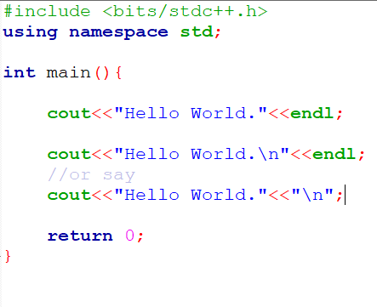
endl VS “\n”
We have been using endl to create a new line.
We could also use “\n” to create a new line.
Which one should we use ? :p

Slide 46
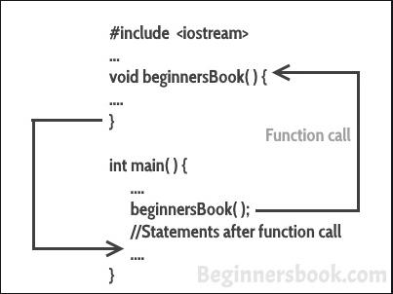
Functions Calling
In java it is known as methods.
https://docs.google.com/document/d/1h7oe1BZlGTYfHz6YI7gJpVlIc7TPbHRo46VNqIQUPNI/edit
Some examples are included here.

Slide 47
Number Theory - sieve of eratosthenes
Here you can find the simulation : https://en.wikipedia.org/wiki/Sieve_of_Eratosthenes
Code : https://ideone.com/ZtM2YQ

Slide 48
Where to Practice
Some online judge
Codeforces - https://codeforces.com/
Codechef - https://www.codechef.com
Lightoj - http://lightoj.com/login_main.php
Uva - https://uva.onlinejudge.org/
Hackerrank - https://www.hackerrank.com/
Spoj - https://www.spoj.com/
A20j - https://a2oj.com/ - here you will find the problems catagorised

Slide 49
Thank You

